Slide 1
the very basics of CTF oriented Forensics

Slide 2
Common stuff
A bit all over the place !
Archive files (ZIP, TAR,GZ,BZ)
Image file formats (JPG, GIF, BMP, PNG)
Packet captures (PCAP, PCAPNG)
PDFs
Audio (especially WAV, MP3)

Slide 3
Archive files (ZIP, TAR,GZ,BZ)
dtrx - do the right extraction
Automatically deals with many archive types quickly
“file” the file??
dongs@bigdong /tmp/bullshit$ file data1
data1: gzip compressed data, was "data2.bin", last modified: Thu Dec 28 13:34:36 2017, max compression, from Unix – deetz and shit

Slide 4
Strings is king
Strings
The strings command returns each string of printable characters in files. Its main uses are to determine the contents of and to extract text from binary files (i.e., non-text files).
strings [options] file_name(s)
Strings –n <x> <file>
The x refers to the min length of string to return

Slide 5
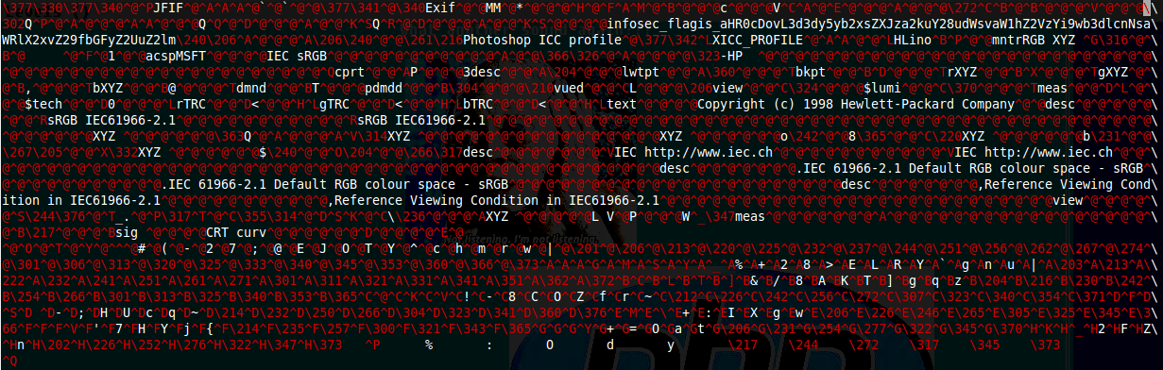
Example of strings in action

Slide 6
Cracking archives
Fcrackzip
John the ripper
Rar2john
Not technically an archive, I think? But For pdfs - pdfcrack

Slide 7
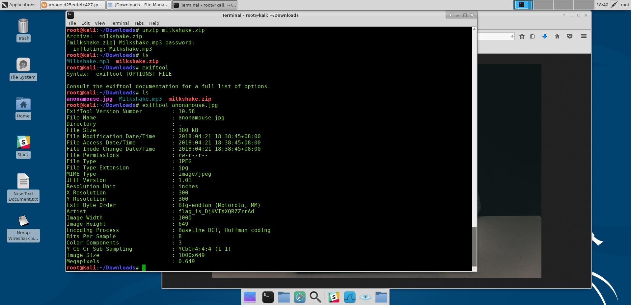
Image file formats (JPG, GIF, BMP, PNG)
Enum:
File the file?
For Metadata – exiftool
Exiftool <file>
Flags are in here sometimes

Slide 8
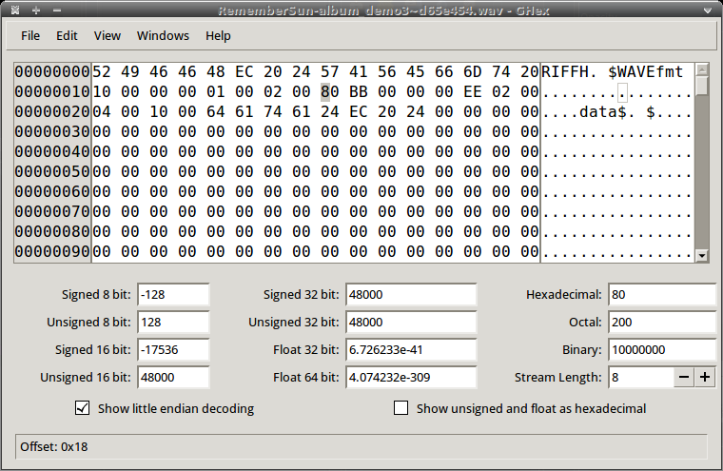
File headers & Bless
Hexeditor – bless or something similar
If you don’t what a particular file is using the file command or something
headers are in every file and they're the same for each file type so it might be handy in some challenge to consider this
Helps with header identification – so you can tell what a file really is?

Slide 9
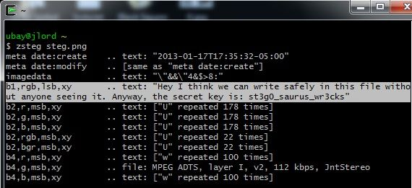
zsteg
If theres a steg challenge:
Zsteg exists!
https://github.com/zed-0xff/zsteg
Can extract things with zsteg too

Slide 10
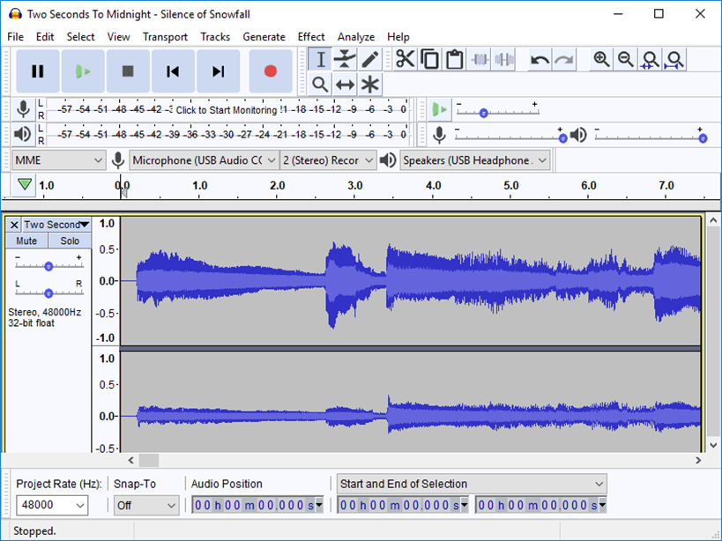
audacity
To deal with audio and midi files from your kali box
Useful for looking at the waveforms. Spectrograms and doing other funky shit with audio - mp3s, wavs, flacs etc

Slide 11
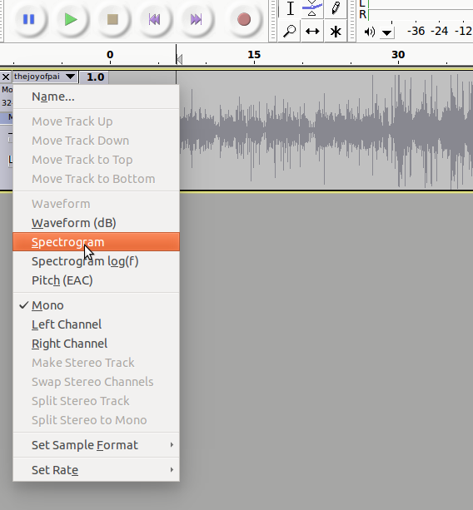
Spectrogram in audacity

Slide 12

Flags are hidden in the spectrogram sometimes?

Slide 13
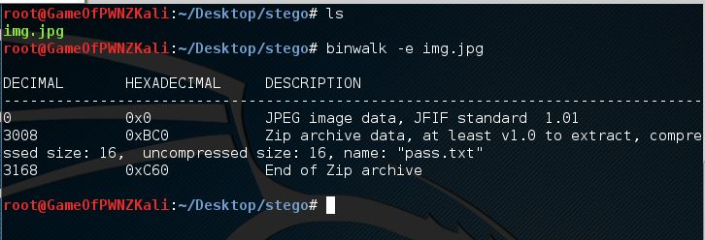
Binwalk
To see if files are hidden within a particular file
Binwalk –e does a simple carving out of the files that lie within the img.jpg in this case – extract the files within the file
Sometime you cant snap one off lol
binwalk --dd='.*'

Slide 14
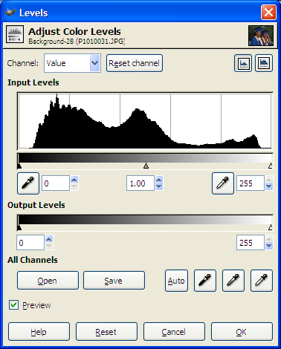
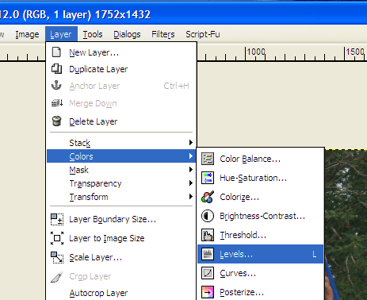
gimp
Gimp is a image editor
Sometimes the flags are on the image itself?
Change stuff like the colour levels
Mess with the input levels/output to reveal flags
Layer > colours > levels

Slide 15
Wireshark
Packet analyser
Used for checking out network traffic
Different protocols
Packets sent/received
Get ctf challenges where stuff is hidden in a packet capture
Pcapng
Pcap
A host of other extenstions

Slide 16
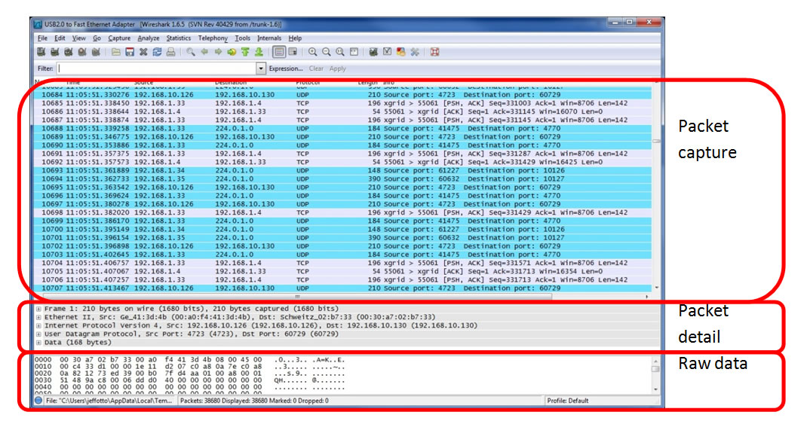
Wireshark

Slide 17
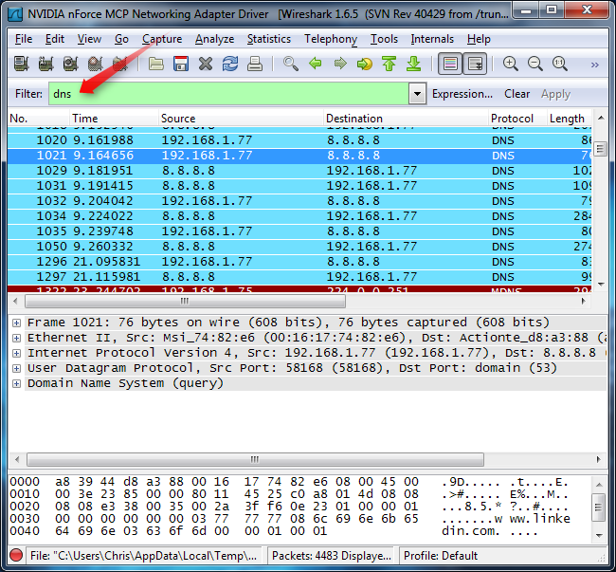
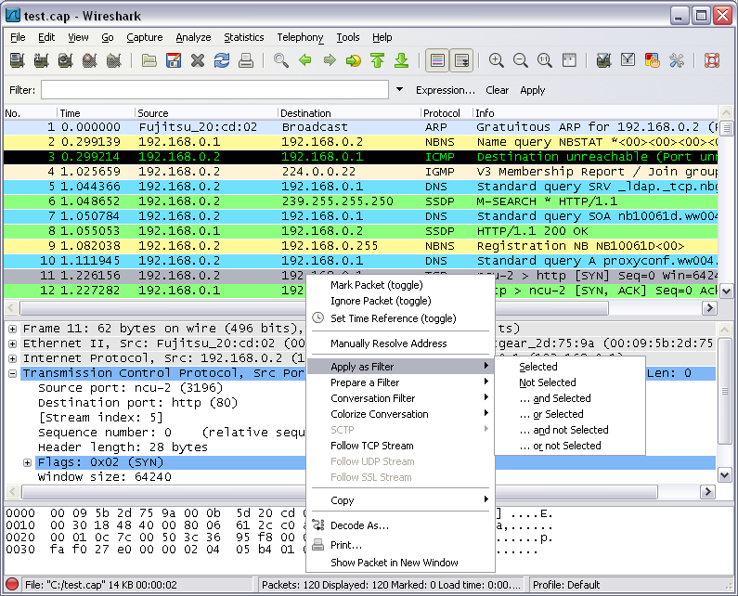
Wireshark

Slide 18
Anyone else?

